Slide 1

Customer Churn Analysis
Transforming data into actionable insights for sustainable business growth and customer retention.

Slide 2
EXECUTIVE OVERVIEW
The Business Challenge
Customer churn directly impacts revenue stability and customer lifetime value. High churn rates signal dissatisfaction, poor customer experience, pricing challenges, or competitive pressure.
5x
Critical insight: Reducing churn is significantly more cost-effective than acquiring new customers.
Cost Difference
More expensive to acquire than retain

Slide 3

Our Analytical Approach
01
02
03
Data Collection
SQL Analysis
Power BI Visualization
Customer demographics, service usage, contract types, and billing behavior
Structured querying to identify churn patterns and high-risk segments
Interactive dashboards for real-time insights and trend analysis

Slide 4

KEY FINDINGS
Critical Churn Drivers
Contract Length
Low Engagement
Month-to-month contracts show significantly higher churn rates compared to long-term commitments
Customers with minimal service usage are strongly correlated with attrition
Pricing Sensitivity
Onboarding Gap
Billing issues and price concerns increase likelihood of customer departure
Early-stage customers churn without proper onboarding and engagement

Slide 5
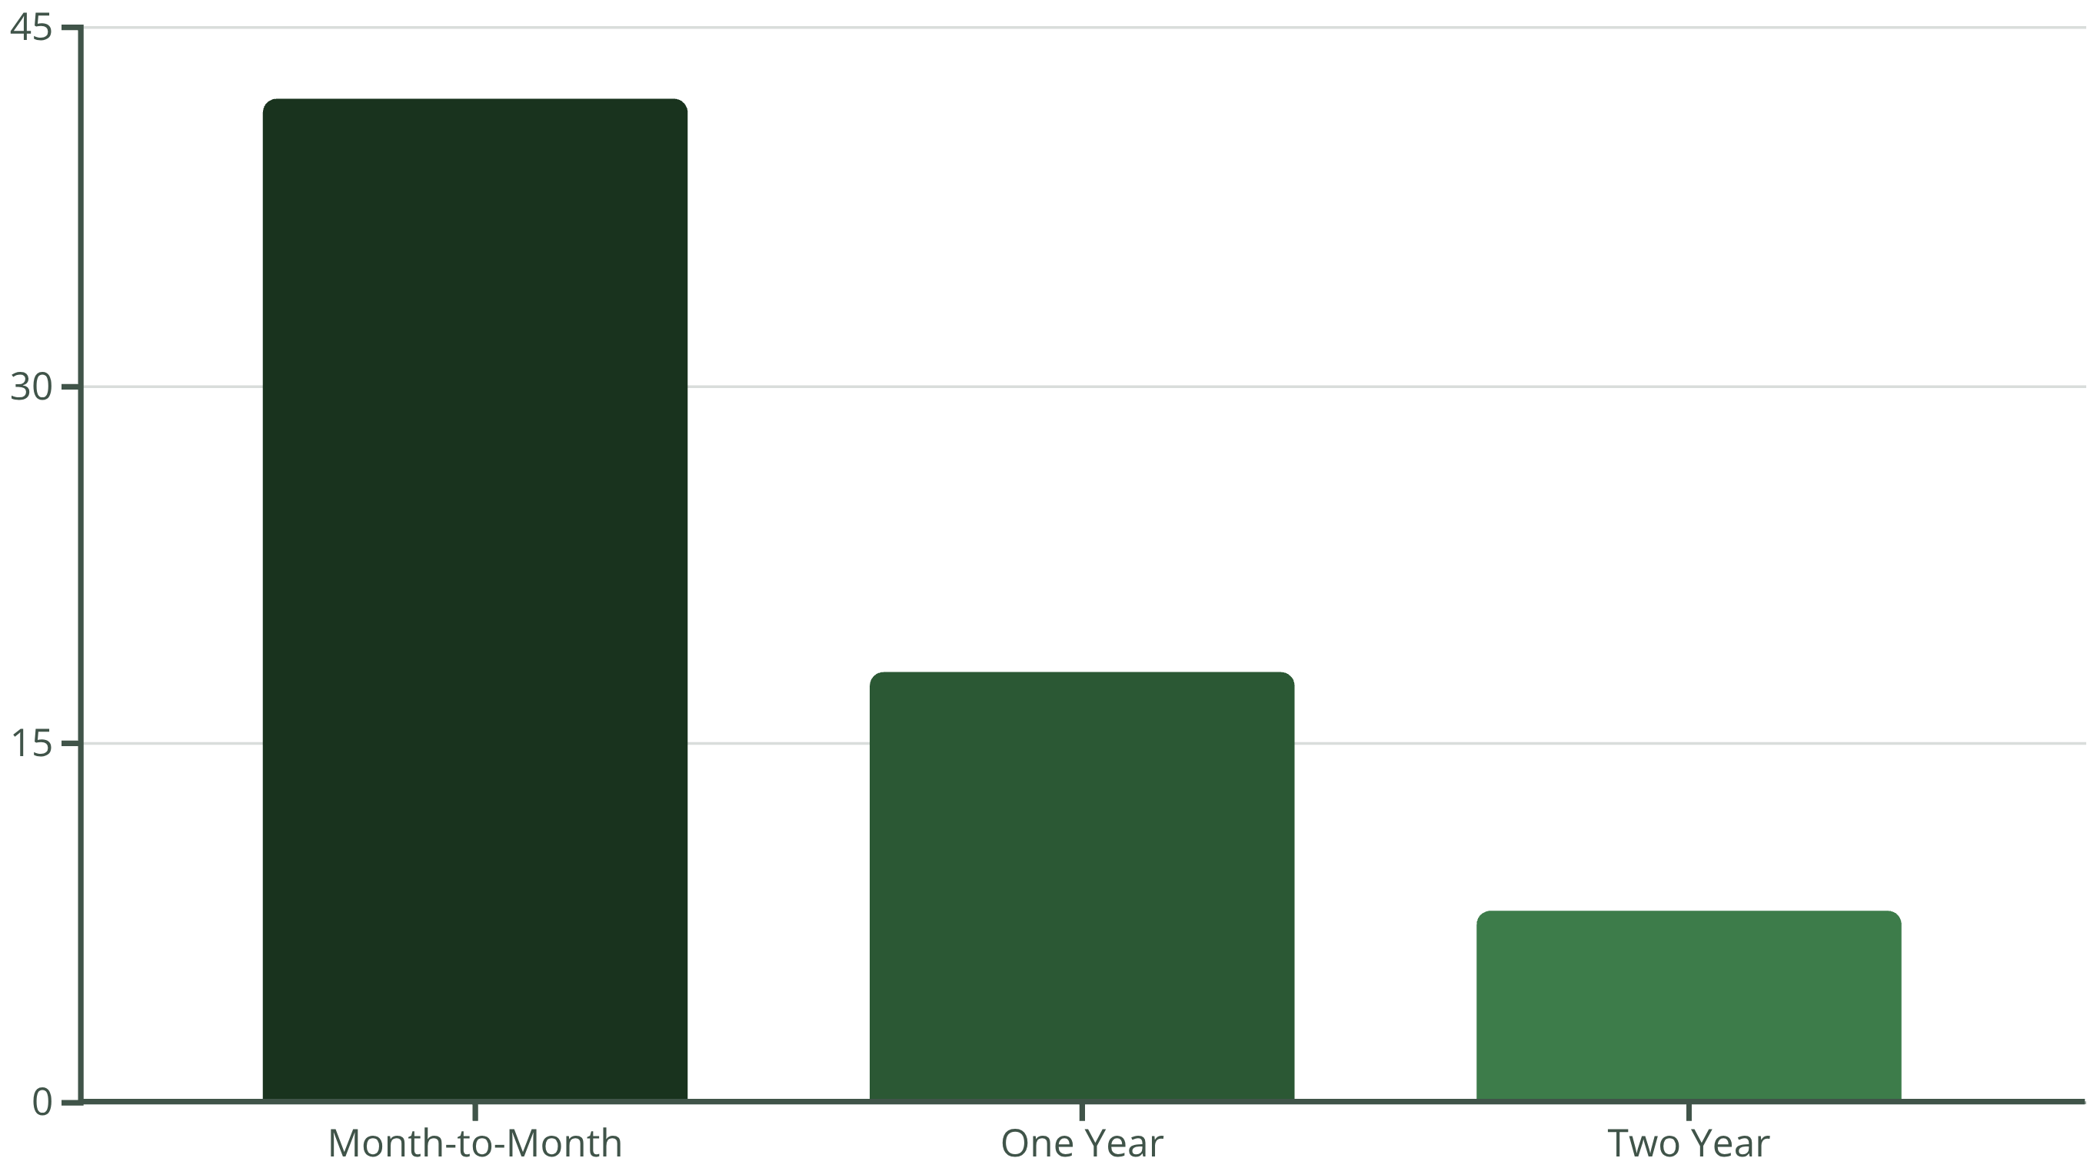
Churn by Contract Type
Short-term contracts exhibit dramatically higher churn rates, highlighting the importance of long-term customer commitment strategies.

Slide 6





Strategic Recommendations
Targeted Retention Programs
Deploy personalized campaigns for high-risk customer segments identified through analytics
Contract Incentives
Offer compelling benefits for long-term contracts and bundled service packages
Enhanced Onboarding
Implement proactive engagement initiatives during critical early customer stages
Real-Time Monitoring
Leverage churn dashboards for immediate intervention and prevention

Slide 7



Business Impact Potential
Key Takeaway: A modest reduction in churn can result in substantial profitability improvements over time, directly increasing customer lifetime value and stabilizing revenue streams.
25%
Revenue Increase
Potential uplift from modest churn reduction
40%
Cost Savings
Lower acquisition expenses
35%
LTV Growth
Improved customer lifetime value

Slide 8

IMPLEMENTATION
Execution Roadmap
1
Phase 1: Deploy
Launch churn monitoring dashboards across all business units
2
Phase 2: Integrate
Connect insights with CRM and marketing platforms
3
Phase 3: Execute
Launch targeted retention campaigns and track performance
4
Phase 4: Optimize
Continuously refine strategies using data-driven feedback

Slide 9

Competitive Advantage
Proactive Prevention
Data-Driven Decisions
Identify at-risk customers before they leave, enabling timely intervention and personalized retention efforts
Transform analytics into actionable strategies that strengthen customer relationships and loyalty
Sustainable Growth
Build long-term competitive positioning through improved satisfaction and reduced customer loss

Slide 10

Moving Forward
Customer churn analysis is a critical capability for sustainable business growth. By transforming data into actionable insights, organizations can proactively reduce customer loss and strengthen competitive positioning.
Next Steps
Review dashboard implementation
Approve retention budget
Launch pilot programs
"The key to retention is understanding why customers leave—and acting before they do."
Schedule quarterly reviews

